Slide 1
Figure 1-1
Files and Assets (.js, .html, .css, images, resources, DLLs, etc.)
AppXManifest.xml
AppBlockMap.xml
Signature
(Some other stuff)
.appx package

Slide 2
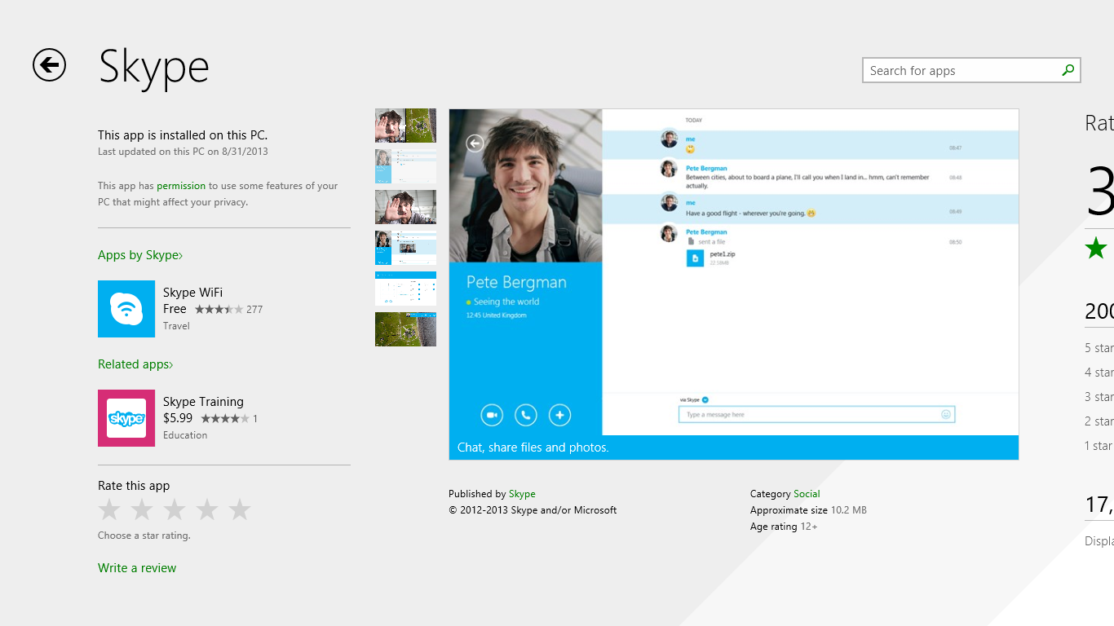
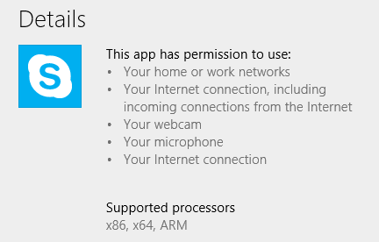
Figure 1-2

Slide 3
Figure 1-3
Download and install app package
Create appdata structures
unzip
App folder (hidden)
html
js
css
images
appxmanifest.xml
etc.
user\appdata\local\packages\<app>
Settings (+ settings.dat)
LocalState
TempState
RoamingState (automatically downloaded from the cloud)
Download and install dependencies
(identified in the manifest)
Create registry entries based on manifest (including Start page tile, etc.)
Registry
unzip
System folders

Slide 4
App folder
html
js
css
images
appxmanifest.xml
etc.
Display
App Container
(on the file system)
App Host Process
JavaScript
Engine
HTML/CSS
Rendering
Engine
Figure 1-4
(in memory)

Slide 5
Direct Access
Communication
via Cloud
AppData Local, Temp, Roaming
Brokered Access
All other areas
Manifest
App Container
App Process
App Host Process
Contracts
App Process
App Process
Direct Access
Brokered Access
Manifest
…
System APIs
App Process

Slide 6
Snapped
Filled
Full
screen
Portrait
Full screen Landscape
or:
Filled
Snapped

Slide 7
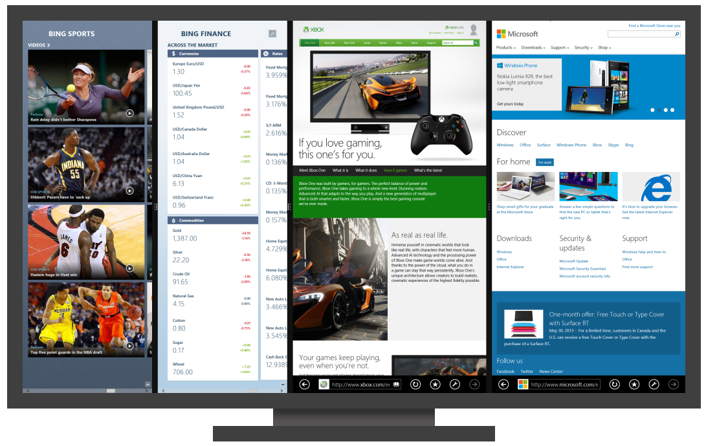
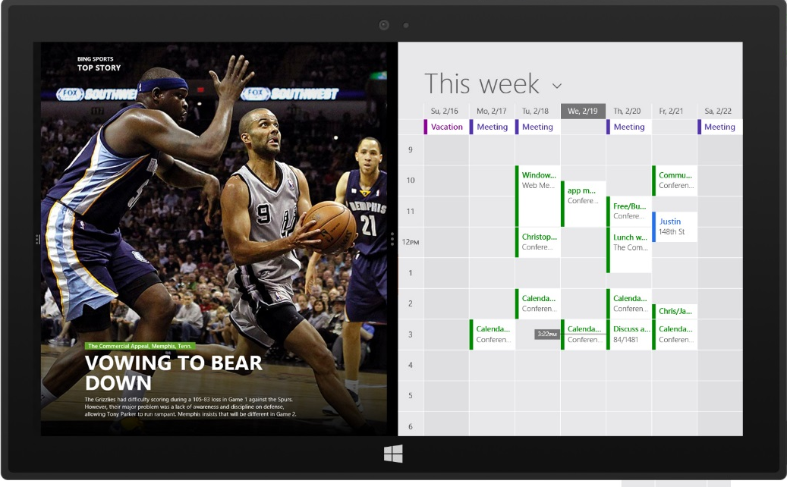

Slide 8
App gets 5s to handle suspend
App is not notified before termination
User Launches App
Running
App
suspending
Suspended
App
Terminated
App
Low Resources
resuming
Apps are notified when they have been resumed
Splash screen
Code gets to run
No code runs
App not running
Limited background tasks can run

Slide 9
Device #1
Device #2
App Container
App Container
App Host Process
App Host Process
Apps use roaming data as if it were just local appdata
AppData
Roaming folder and settings
AppData
Roaming folder and settings
Roaming data (up to 100K) automatically synced between devices with same app and same user account

